Slide 1


Interns Skills and Description about project
Presentation by:
Divyaprada G

Slide 2

AGENDA
o1. Basic Skills and Technical Knowledge
o2. Core Java Skills
o3. Tasks Assigned for the Interns
o4. Interns Job Role and Responsibilities.
o5. Challenges Faced in Internship

Slide 3
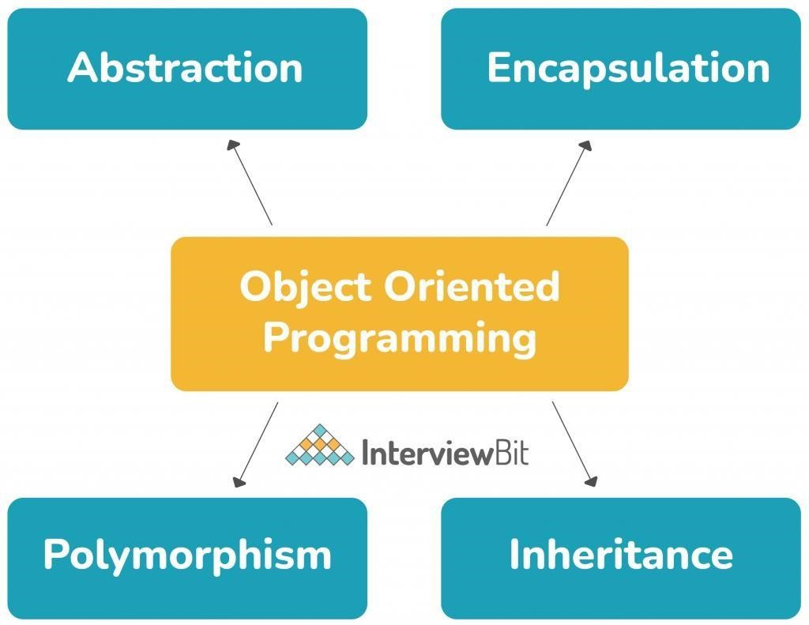
Basic Skill and Technical Knowledge
Object-Oriented-Programming

Slide 4
There are various advantages of object-oriented programming over procedural programming:
OOP is a more efficient and straightforward method of programming. The programs have a clear structure thanks to OOP.
OOP makes it easier to maintain, alter, and debug Java code by keeping it DRY (Don’t Repeat Yourself). OOP allows developers to construct fully reusable apps with less code and in less time.
The Object-Oriented Programming methodology introduces the principles of inheritance, encapsulation, abstraction, and polymorphism through the use of classes and objects. The goal of OOP is to connect data and functions in order to increase code stability and security.
You must be thoroughly clear with these concepts as they are the basis of the Java programming language.

Slide 5
Web Technologies
Web technology makes it easy and quick to produce dynamic web content. Understanding the concept of establishing communication between many computer systems via markup languages requires a greater understanding of Web technologies.
It allows users to communicate with the host for information, similar to how web pages work.
HTML, JQuery, and CSS are all often used in projects.

Slide 6
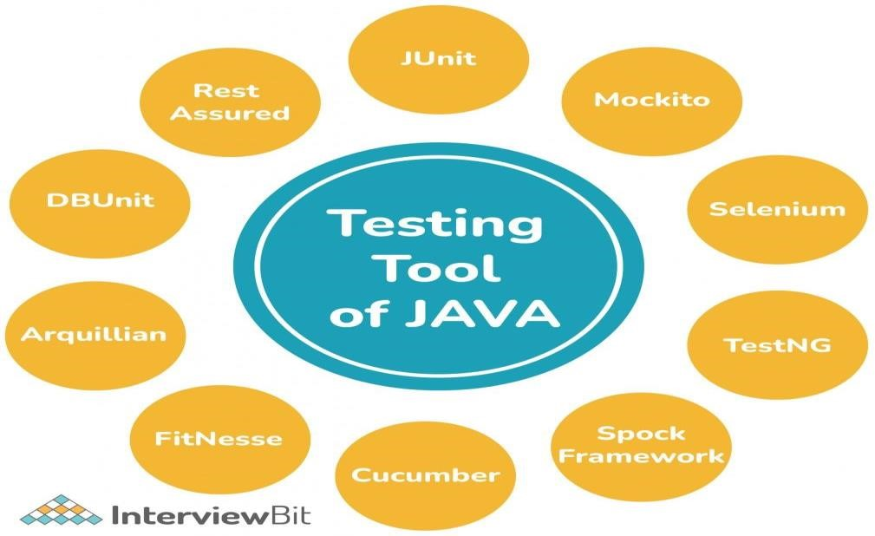
Java Testing Tools

Slide 7
Core Java Skills
1. Web Frameworks
2. Application Containers
3. Unit Testing
4. Java EE Components
Soft Skills
1. Team Work
2. Ready to learn new things
3. Communication Skills

Slide 8
1. Web Frameworks
Java web frameworks are the best in class solutions for building a Mobile application with the best features and the least amount of code.
They enable the creation and deployment of web applications on the World Wide Web in a uniform manner, including web services, web resources, and web APIs. Spring MVC and Play are two of the greatest frameworks.
Spring is currently built on the Model-View-Controller (MVC) framework, which divides the operations, business, and representation layers.

Slide 9
2.Team work :
Teamwork establishes a method for meeting deadlines and producing high-quality work.
When work is distributed among team members, it is completed faster, allowing the business to operate more efficiently.
As you work toward a common objective, your team will build a sense of togetherness.
3.Ready to learn new things :
Knowledge is limitless. Successful Java developers are always on the lookout for new technological advancements and keep themselves up to date.

Slide 10
3. Communication Skills
Good communication skills aid in the development of greater understanding and beliefs among individuals, inspiring them to adhere to the concepts and ideals instilled in them by their leader.
Active listening, in which you pay great attention to the person speaking to you, and attempt to adjust your communication style to your audience in order to express your message more effectively, are example of good communication skills.
The better the communication Skills, the better chances of growth in one’s career.

Slide 11
Tasks Assigned for the Interns
Creation of Java Front End Applications and connecting to the database
Here each Intern has to take care of creation of User-Friendly GUI. Then Write a java backend code with Database connection using JDBC.
Intern’s performance on assigned tasks and project to be finished and meet the following requirements.
Quality of Work :-
Meets productivity standards; completes work in a quick and timely manner; strives to increase productivity.
Quality of Work :-
Demonstrates accuracy and thoroughness; displays commitment to excellence; looks for ways to improve and promote quality; shows good attention to detail.

Slide 12
Work Ethic :-
Demonstrates a good work ethic; offers assistance and support to coworkers; willing to go the extra mile; makes maximum use of time.
Job Knowledge and Competency :-
Competent in required job skills and knowledge; exhibits ability to lean and apply new skills; keeps abreast of current developments in field; requires minimal supervision.
Teachability :-
Shows an openness and eagerness to learn from others; accepts criticism and feedback; applies feedback to improve performance; open to new ways of doing things.
Communication :-
Exhibits good listening and comprehension; expresses ideas and thoughts effectively; keeps other adequately informed; resolves conflict effectively and timely.

Slide 13
Interns Job Role and Responsibilities
We have a group of 40 Members, each will getting the task to finish it. And we should report to project manager during meeting held at company weekly.
Our team made for Development of Application with the help of java programming Language.

Slide 14
Challenges Faced in Internship
We are new to the Techniques and we facing the challenges during learning stage of the Full stack development and cloud itself because Full Stack Development and AWS is a vast to learn and make work as a fresher /intern, its bit difficult and it’s a challenging task to us.

Slide 15


THE END
Thank You

